Slide 1

Chapter 2.1 Collaborative Filtering

Slide 2
Outline
Memory-based approaches
User-based CF
Item-based CF
Similarity measures
Preference feedback
Model-based approaches
Matrix factorization
Factorization machine
Remarks of collaborative filtering

Slide 3
Collaborative Filtering (CF)
The most prominent approach to generate recommendations
used by large, commercial e-commerce sites
well-understood, various algorithms and variations exist
applicable in many domains (book, movies, ...)
Approach
use the "wisdom of the crowd" to recommend items
Basic assumption and idea
Users give ratings to catalog items (implicitly or explicitly)
The users who had similar tastes in the past, will have similar tastes in the future
Notes:
营销：口碑营销；word-of-mouth;
网络：水军；“自来水”；

Slide 4
Pure CF Approaches
Input
Only a matrix of given user–item ratings
Output types
A (numerical) prediction indicating to what degree the current user will like or dislike a certain item, a.k.a. rating prediction
A top-N list of recommended items, a.k.a., item ranking or item recommendation

Slide 5
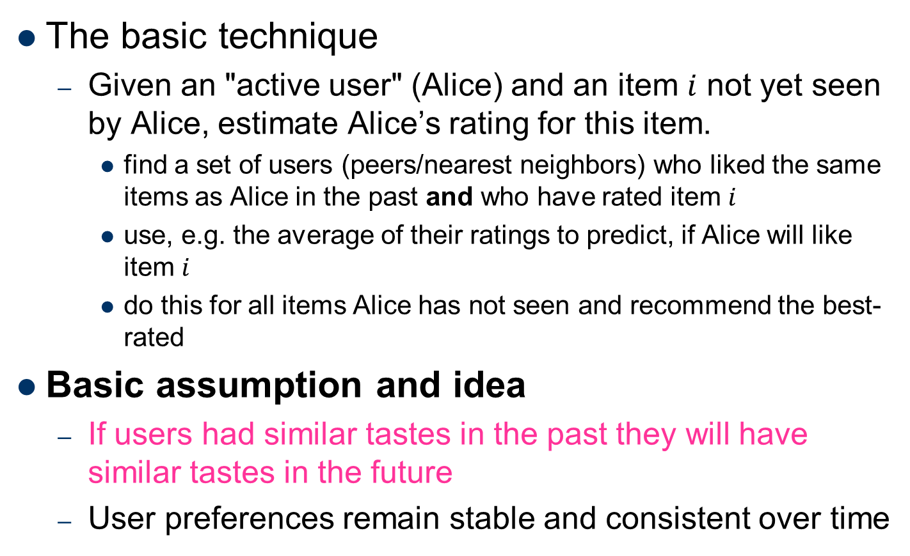
User-based CF
The basic technique
Given an "active user" (Alice) and an item $i$ not yet seen by Alice, estimate Alice’s rating for this item.
find a set of users (peers/nearest neighbors) who liked the same items as Alice in the past and who have rated item $i$
use, e.g. the average of their ratings to predict, if Alice will like item $i$
do this for all items Alice has not seen and recommend the best-rated
Basic assumption and idea
If users had similar tastes in the past they will have similar tastes in the future
User preferences remain stable and consistent over time

Slide 6
User-based CF (2)
Procedure
Step 1: compute user-user similarity
Step 2: form nearest neighborhood ordered by user similarity
Step 3: aggregate nearest neighbors’ opinions to generate recommendations

Slide 7
User-based CF (3)
Example
A database of ratings of the current user, Alice, and some other users is given:
Determine whether Alice will like or dislike Item5, which Alice has not yet rated or seen
 | Item1 | Item2 | Item3 | Item4 | Item5
Alice | 5 | 3 | 4 | 4 | ?
User1 | 3 | 1 | 2 | 3 | 3
User2 | 4 | 3 | 4 | 3 | 5
User3 | 3 | 3 | 1 | 5 | 4
User4 | 1 | 5 | 5 | 2 | 1

Slide 8
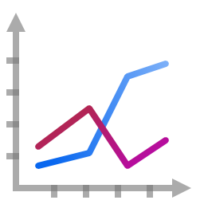
User-based CF (4)
Some first questions
How do we measure similarity?
How many neighbors should we consider?
How do we generate a prediction from the neighbors' ratings?
 | Item1 | Item2 | Item3 | Item4 | Item5
Alice | 5 | 3 | 4 | 4 | ?
User1 | 3 | 1 | 2 | 3 | 3
User2 | 4 | 3 | 4 | 3 | 5
User3 | 3 | 3 | 1 | 5 | 4
User4 | 1 | 5 | 5 | 2 | 1

Slide 9
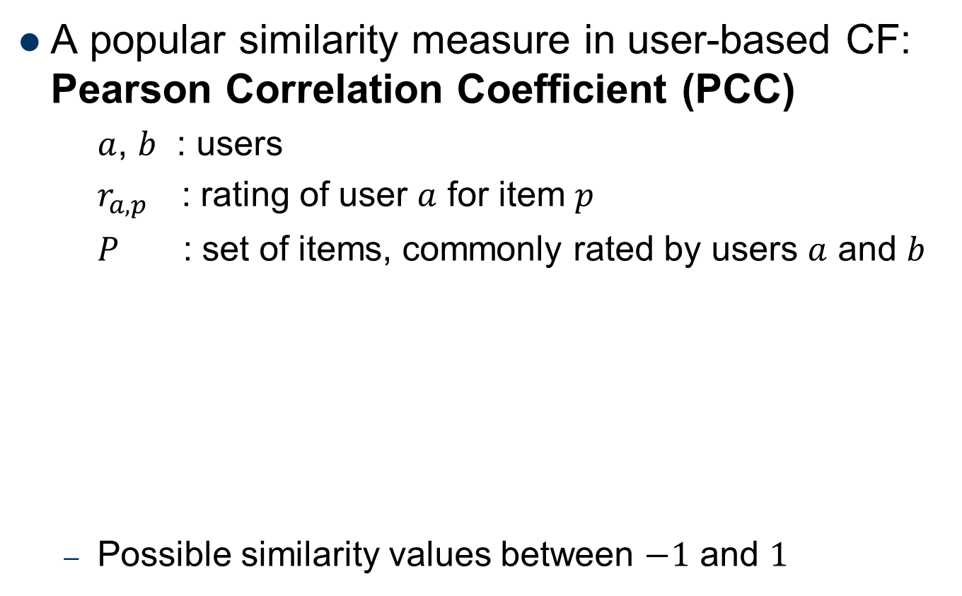
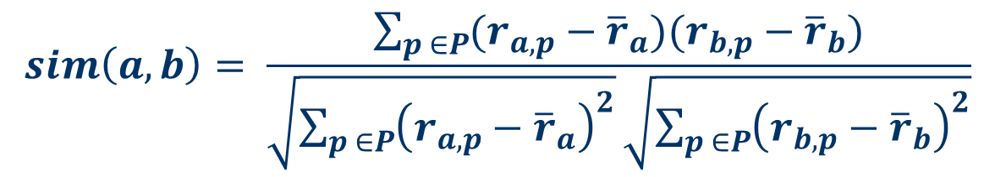
User similarity
A popular similarity measure in user-based CF: Pearson Correlation Coefficient (PCC)
$a$, $b$ : users
$r_{a,p}$ : rating of user $a$ for item $p$
$P$ : set of items, commonly rated by users $a$ and $b$
Possible similarity values between $−1$ and $1$
$$sim\left(a,b\right)= \frac{\sum_{p ∈P}{(r_{a,p}−{\overline{r}}_{a})(r_{b,p}−{\overline{r}}_{b})}}{\sqrt{\sum_{p ∈P}{{\left(r_{a,p}−{\overline{r}}_{a}\right)}^{2}}}\sqrt{\sum_{p ∈P}{{\left(r_{b,p}−{\overline{r}}_{b}\right)}^{2}}}}$$
Notes:
Explain the meanings of similarity value, -1: dissimilar; 1: similar; 0: uncorrelated.

Slide 10
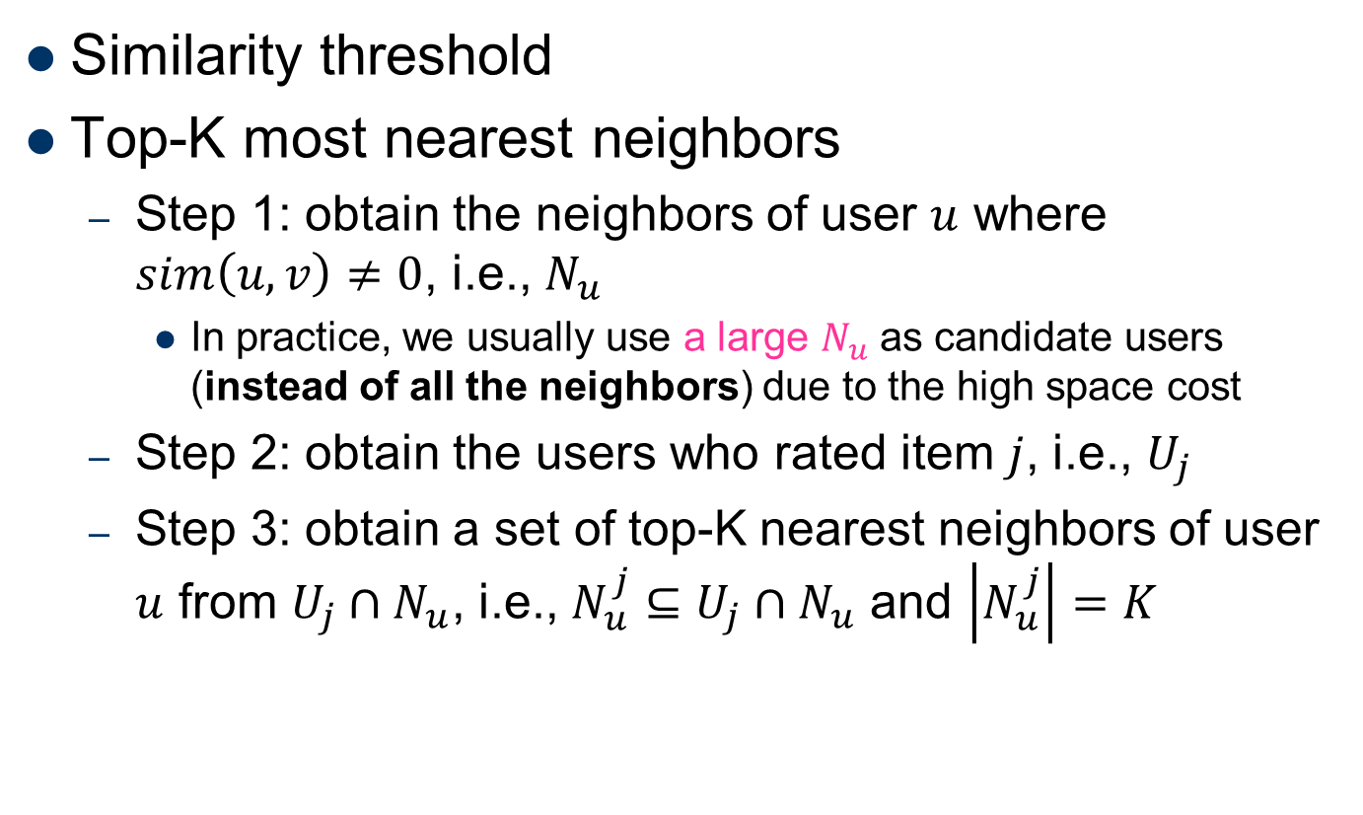
Neighborhood Selection
Similarity threshold
Top-K most nearest neighbors
Step 1: obtain the neighbors of user $u$ where $sim\left(u,v\right)≠0$, i.e., $N_{u}$
In practice, we usually use a large $N_{u}$ as candidate users (instead of all the neighbors) due to the high space cost
Step 2: obtain the users who rated item $j$, i.e., $U_{j}$
Step 3: obtain a set of top-K nearest neighbors of user $u$ from $U_{j}∩N_{u}$, i.e., $N_{u}^{j}⊆U_{j}∩N_{u}$ and $\left|N_{u}^{j}\right|=K$
Notes:
Difficult to find a proper threshold value.

Slide 11
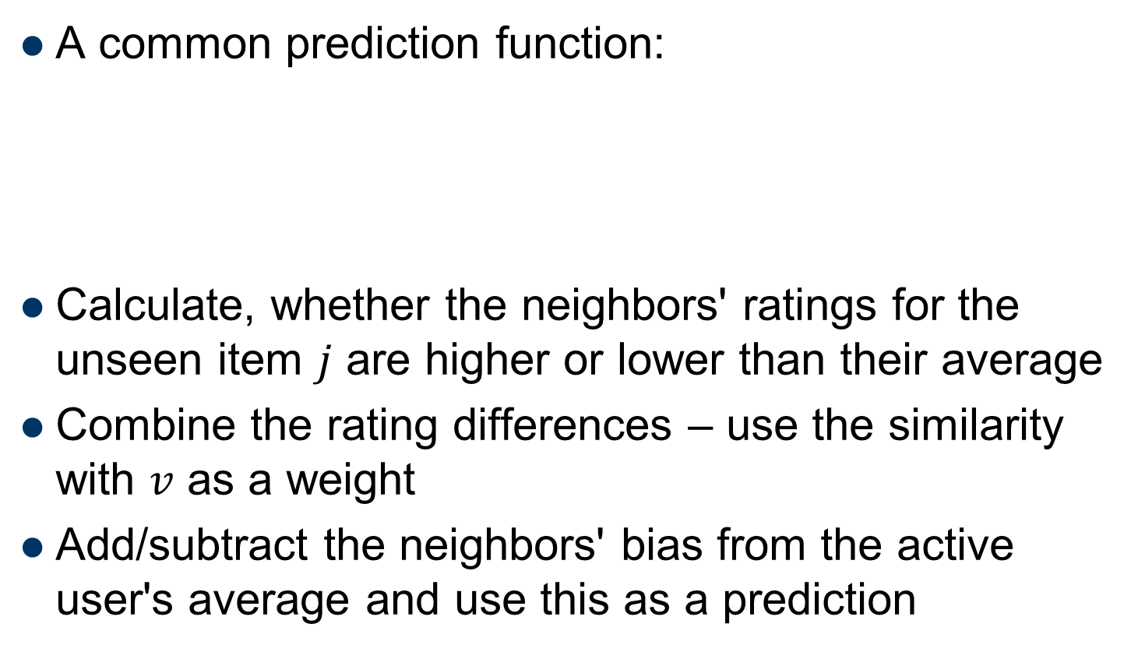
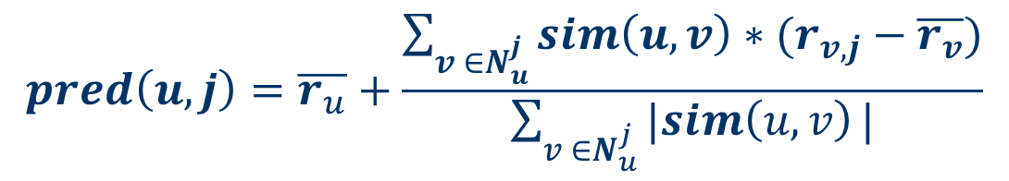
Making predictions
A common prediction function:
Calculate, whether the neighbors' ratings for the unseen item $j$ are higher or lower than their average
Combine the rating differences – use the similarity with $v$ as a weight
Add/subtract the neighbors' bias from the active user's average and use this as a prediction
$$pred\left(u,j\right)=\overline{r_{u}}+\frac{\sum_{v ∈N_{u}^{j}}{sim\left(u,v\right)∗(r_{v,j}−\overline{r_{v}})}}{\sum_{v ∈N_{u}^{j}}{|sim\left(u,v\right)}|}$$

Slide 12
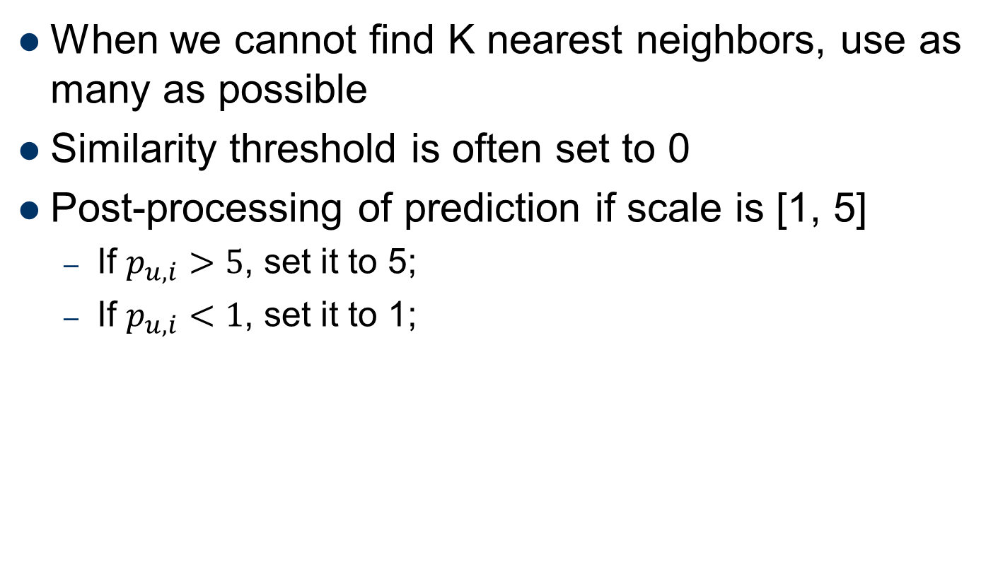
Implementation Details
When we cannot find K nearest neighbors, use as many as possible
Similarity threshold is often set to 0
Post-processing of prediction if scale is [1, 5]
If $p_{u,i}>5$, set it to 5;
If $p_{u,i}<1$, set it to 1;

Slide 13
Evaluation
movies
1 | 3 | 4
 | 3 | 5 |  |  | 5
 |  | 4 | 5 |  | 5
 |  | 3
 |  | 3
2 |  |  | 2 |  | 2
 |  |  |  | 5
 | 2 | 1 |  |  | 1
 | 3 |  |  | 3
1
users

Slide 14
Evaluation (2)
movies
1 | 3 | 4
 | 3 | 5 |  |  | 5
 |  | 4 | 5 |  | 5
 |  | 3
 |  | 3
2 |  |  | ? |  | ?
 |  |  |  | ?
 | 2 | 1 |  |  | ?
 | 3 |  |  | ?
1
users
Test Data Set

Slide 15
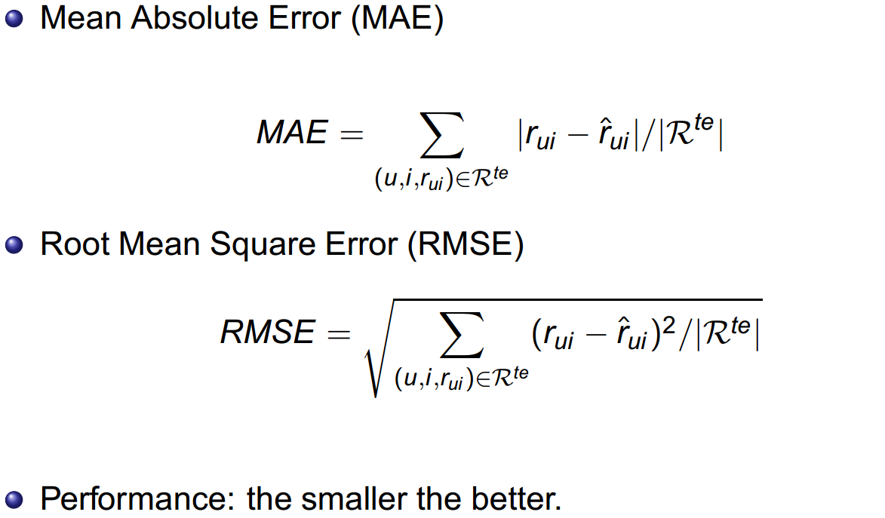
Evaluation (3)

Slide 16
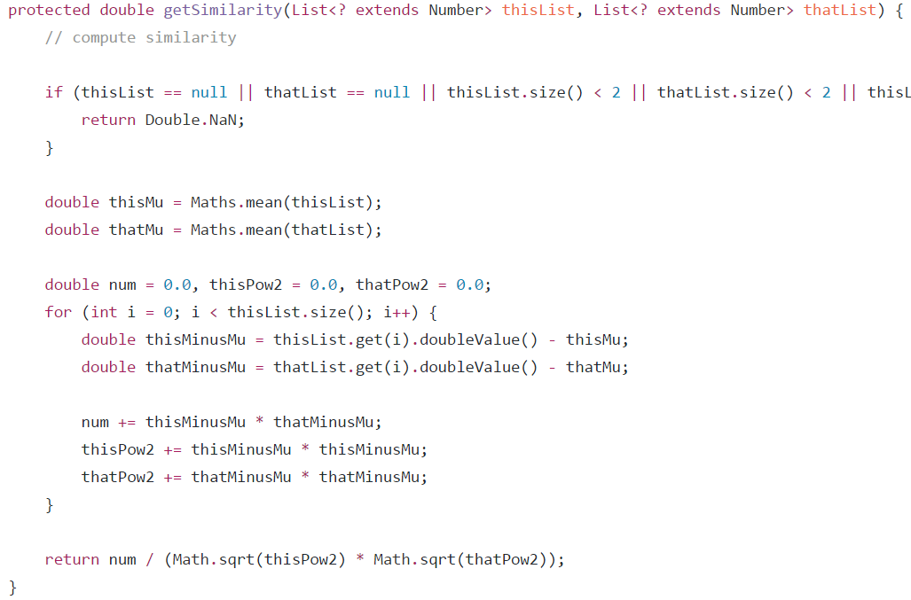
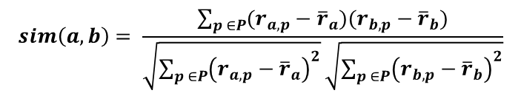
Implementations in LibRec 2.0
PCCSimilarity
$$sim\left(a,b\right)= \frac{\sum_{p ∈P}{(r_{a,p}−{\overline{r}}_{a})(r_{b,p}−{\overline{r}}_{b})}}{\sqrt{\sum_{p ∈P}{{\left(r_{a,p}−{\overline{r}}_{a}\right)}^{2}}}\sqrt{\sum_{p ∈P}{{\left(r_{b,p}−{\overline{r}}_{b}\right)}^{2}}}}$$

Slide 17
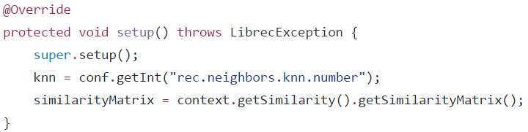
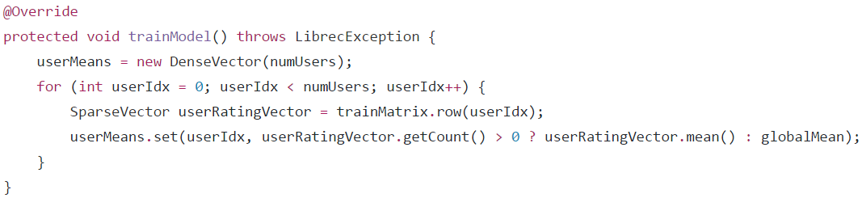
Implementations in LibRec 2.0 (2)
UserKNN
1. Compute user similarities
2. Compute user means

Slide 18
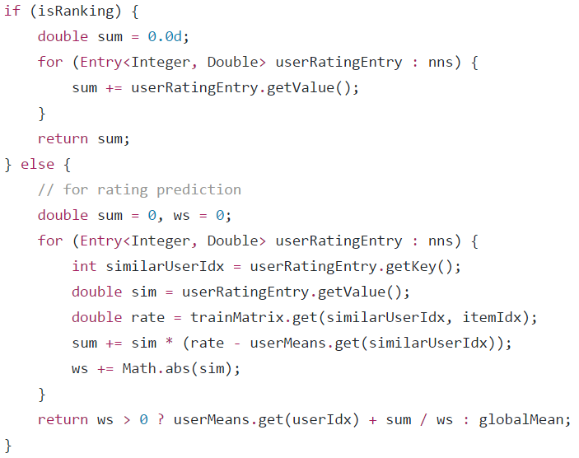
Implementations in LibRec 2.0 (3)
UserKNN
3. Generate recommendations

Slide 19
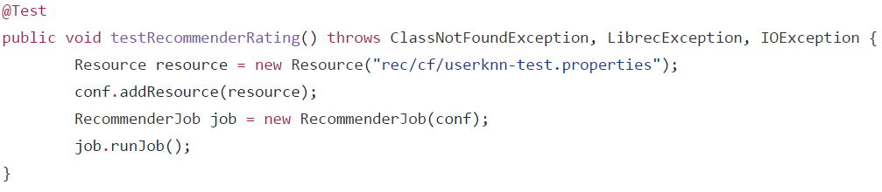
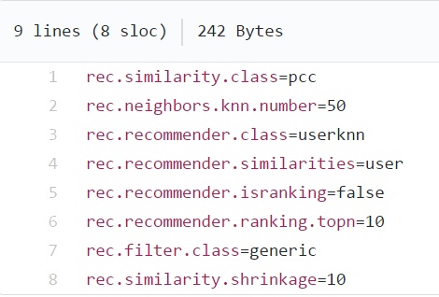
Implementations in LibRec 2.0 (4)
UserKNNTestCase
userknn-test.properties
Let’s try!!!

Slide 20
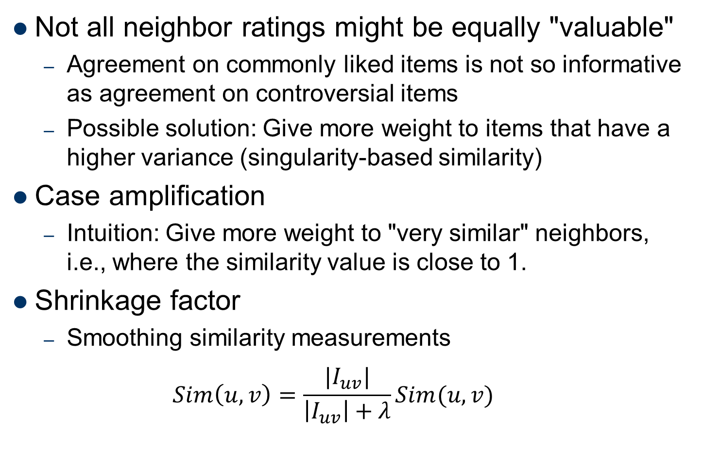
Improving the user-based CF
Not all neighbor ratings might be equally "valuable"
Agreement on commonly liked items is not so informative as agreement on controversial items
Possible solution: Give more weight to items that have a higher variance (singularity-based similarity)
Case amplification
Intuition: Give more weight to "very similar" neighbors, i.e., where the similarity value is close to 1.
Shrinkage factor
Smoothing similarity measurements
$$Sim\left(u, v\right)=\frac{|I_{uv}|}{\left|I_{uv}\right|+λ}Sim(u,v)$$

Slide 21
Item-based CF
Basic assumption:
A user will like the items similar to those she liked before
Example:
Look for items that are similar to Item5
Take Alice's ratings for these items to predict the rating for Item5
 | Item1 | Item2 | Item3 | Item4 | Item5
Alice | 5 | 3 | 4 | 4 | ?
User1 | 3 | 1 | 2 | 3 | 3
User2 | 4 | 3 | 4 | 3 | 5
User3 | 3 | 3 | 1 | 5 | 4
User4 | 1 | 5 | 5 | 2 | 1
Notes:
Item-based collaborative filtering recommendation algorithms, B. Sarwar et al., WWW 2001

Slide 22
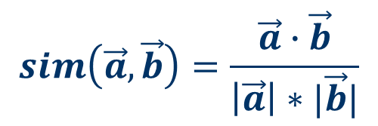
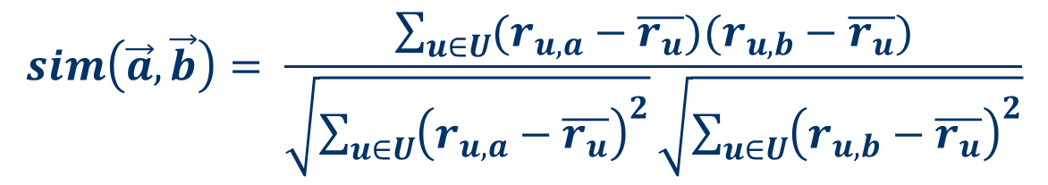
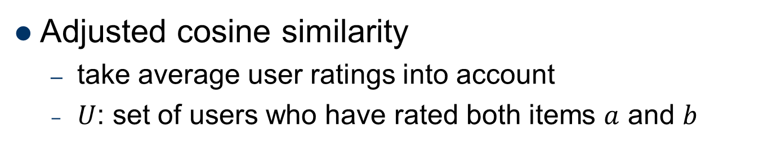
Cosine similarity
Produces better results in item-based CF
Cosine similarity is calculated based on the angle between the rating vectors
$$sim\left(\vec{a},\vec{b}\right)=\frac{\vec{a}∙\vec{b}}{\left|\vec{a}\right|∗|\vec{b}|}$$
Adjusted cosine similarity
take average user ratings into account
$U$: set of users who have rated both items $a$ and $b$
$$sim\left(\vec{a},\vec{b}\right)= \frac{\sum_{u∈U}{(r_{u,a}−\overline{r_{u}})(r_{u,b}−\overline{r_{u}})}}{\sqrt{\sum_{u∈U}{{\left(r_{u,a}−\overline{r_{u}}\right)}^{2}}}\sqrt{\sum_{u∈U}{{\left(r_{u,b}−\overline{r_{u}}\right)}^{2}}}}$$

Slide 23
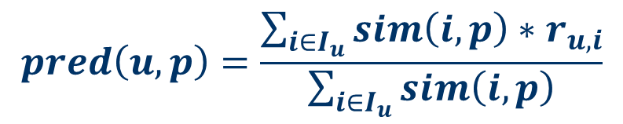
Making predictions
A common prediction function:
Neighborhood size is typically also limited to a specific size
Not all neighbors are taken into account for the prediction
An analysis of the MovieLens dataset indicates that "in most real-world situations, a neighborhood of 20 to 50 neighbors seems reasonable" (Herlocker et al. 2002)
$$pred\left(u,p\right)=\frac{\sum_{i∈I_{u}}{sim\left(i,p\right)∗r_{u,i}}}{\sum_{i∈I_{u}}{sim\left(i,p\right)}}$$

Slide 24
Pre-computed item similarities
Item-based CF does not solve the scalability problem itself
User-based CF: expensive online similarity computation
Pre-processing approach by Amazon.com (in 2003)
Calculate all pair-wise item similarities in advance
Item similarities are supposed to be more stable than user similarities
The neighborhood to be used at run-time is typically rather small, because only items are taken into account which the user has rated

Slide 25
Complexity of item-based CF
Memory requirements
Up to N² pair-wise similarities to be memorized (N = number of items) in theory
In practice, this is significantly lower (items with no co-ratings)
Further reductions possible
Minimum threshold for co-ratings
Limit the neighborhood size (might affect recommendation accuracy)

Slide 26
What the authors say about ItemCF?
ItemCF
G. Linden, B. Smith, and J. York, “Amazon.com Recommendations: Item-to-Item Collaborative Filtering,” IEEE Internet Computing, vol. 7, no. 1, 2003, pp. 76–80.
Two Decades of Recommender Systems At Amazon.com
B. Smith and G. Linden
IEEE Internet Computing, May 2017
https://www.computer.org/csdl/mags/ic/2017/03/mic2017030012.html (in English)
https://mp.weixin.qq.com/s/XM2-5qfhOvydHoSV-x-WAQ (in Chinese with additional notes)
Main content: ItemCF algorithm, Define relevance, Time & Sequence, and future vision of recommender systems.
Notes:
比较有趣的一点是：数码相机与存储卡的型号存在兼容性的关系。如果手工去编辑产品与产品之间的兼容性数据库（亚马逊的商品库中有几十万中存储卡），将会是非常昂贵且容易出错的。通过推荐时物品之间的相关性，可以从用户的行为中学习出这种兼容性，使错误信号逐渐消失。

Slide 27
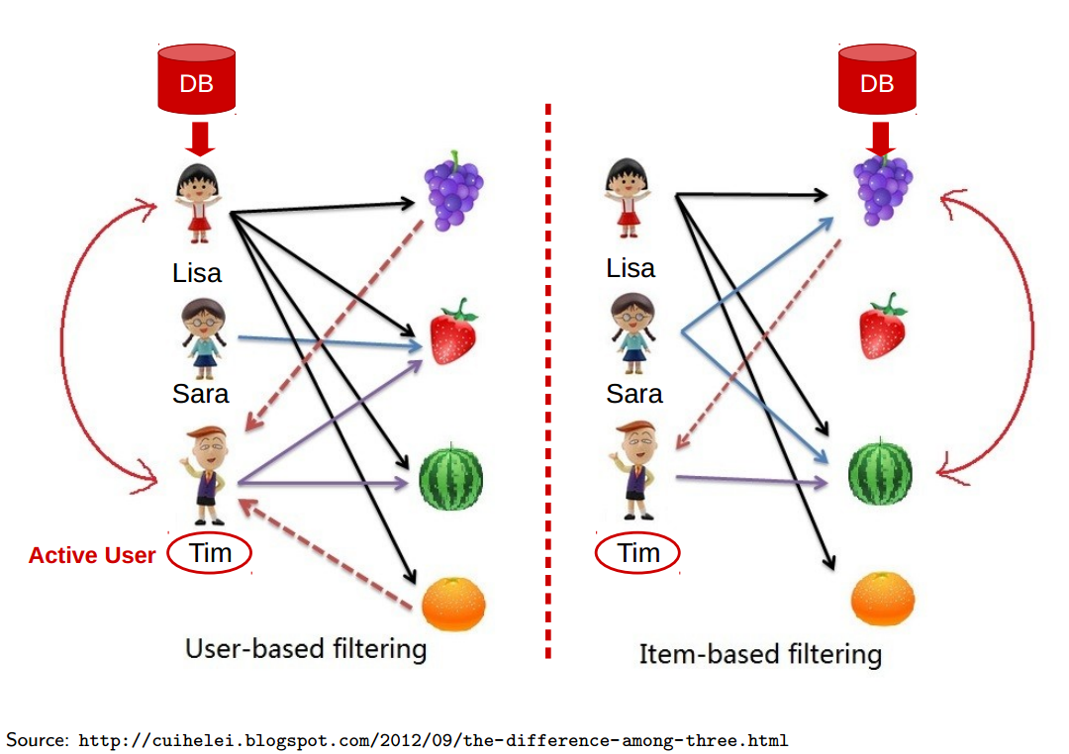
User- vs. Item-based CF
Which method to use in a real application?

Slide 28
User- vs. Item-based CF (2)
Explainability
User-based CF:
“Users that read this book also read ...”
Item-based CF:
“You read these 10 books, so you might also like to read ..."
Complexity
User-based CF: Number of users << number of items
Item-based CF: Number of items << number of users
Performance
In general: item-based CF > user-based CF
Why? Items are simpler, users have multiple tastes
Notes:
Intuitively, items tend to be classifiable in simple terms. For example, music tends to belong to a single genre. It is impossible, e.g., for a piece of music to be both 60’s rock and 1700’s baroque. On the other hand, there are individuals who like both 60’s rock and 1700’s baroque, and who buy examples of both types of music.

Slide 29
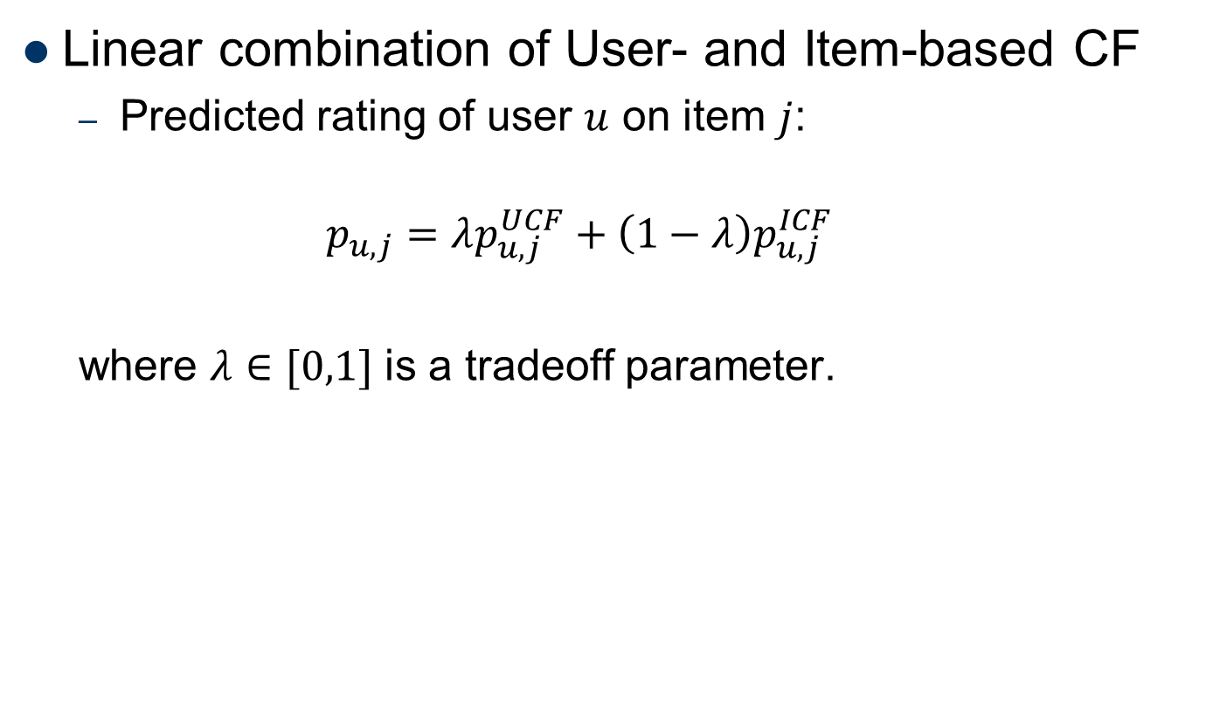
Hybrid CF
Linear combination of User- and Item-based CF
Predicted rating of user $u$ on item $j$:
$$p_{u,j}=λp_{u,j}^{UCF}+\left(1−λ\right)p_{u,j}^{ICF}$$
where $λ∈[0,1]$ is a tradeoff parameter.

Slide 30
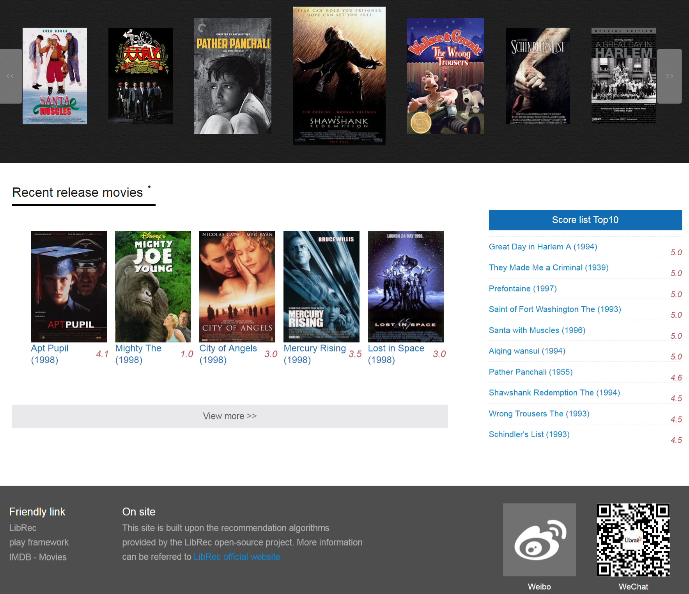
LibRec Demo
http://demo.liaotian2020.com/ (http://demo.librec.net )
https://github.com/395299296/librec-to-movies

Slide 31
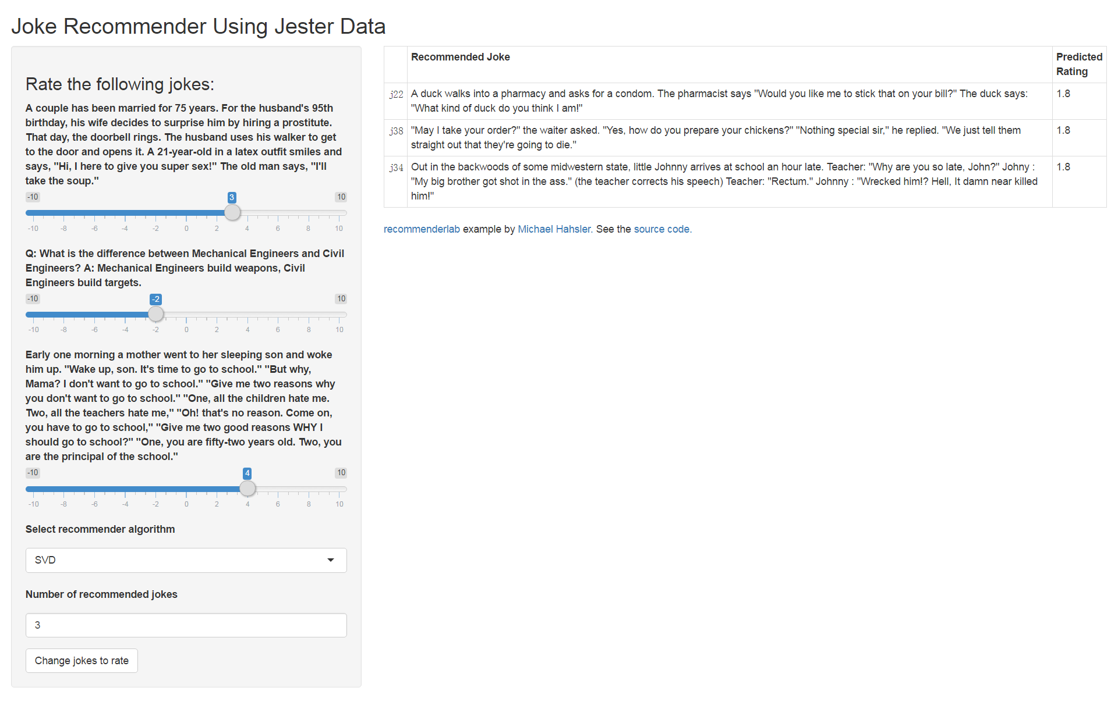
Online Trials
https://mhahsler-apps.shinyapps.io/Jester/

Slide 32
Outline
Memory-based approaches
User-based CF
Item-based CF
Similarity measures (2.2)
Model-based approaches
Matrix factorization
Factorization machine
Remarks of collaborative filtering

Slide 33
Outline
Memory-based approaches
User-based CF
Item-based CF
Similarity measures
Model-based approaches
Matrix factorization (2.3)
Factorization machine (2.4)
Remarks of collaborative filtering

Slide 34
Remarks Of Collaborative Filtering

Slide 35


CF: conclusions
Pros:
well-understood, works well in some domains, no knowledge/feature engineering required
Cons:
requires user community, sparsity problems, no integration of other knowledge sources, no explanation of results, tends to recommend popular items
What is the best CF method?
In different situation and domain: inconsistent findings;
Always the same domains and data sets: differences between methods are often very small

Slide 36
CF: some issues
How to evaluate the prediction quality?
MAE / RMSE: What does an MAE of 0.7 actually mean?
Serendipity (novelty and surprising effect of recommendations)
Not yet fully understood
What about multi-dimensional ratings?
Why a rating is missing?
MNAR: Missing Not At Random assumption
MAR: “The process that selects the observed data is independent of the value of unobserved rating data”
“I checked this music shared by my friends, and I didn’t like it”

Slide 37
CF Tip: add data
Leverage all the data
Don’t try to reduce data size in an effort to make fancy algorithms work
Simple methods on large data do best
Add more data
e.g., add IMDB data on genres
More data beats better algorithms
http://anand.typepad.com/datawocky/2008/03/more-data-usual.html

Slide 38
CF: security
Protect recommender neutrality
From malicious users who want to push their product and can create fake accounts
Possible solutions: prevent account creation or detect and remove
Protect recommender accuracy
From users who give low-quality, inconsistent ratings
Possible solutions: normal de-noising problem
Protect user data (privacy)
From other user and from the service provider
Possible solutions: use trusted computing infrastructure, pool ratings, add noise

